Slide 1

Team Details
Team name: Nexus Innovators
Team leader name: Hemant Rambhau Dhavale
Problem Statement: "Challenges in Electric Vehicle (EV) Charging Infrastructure: Inconvenience, Limited Range, and Insufficient Charging Stations"
Notes:
Our first slide is the cover. It should include the project title, the team's name, and the team leader's name. Keep it professional and visually appealing.

Slide 2

Problem Addressed:
🔴 Traditional EV charging is slow and inconvenient
🔵 Limited charging stations cause range anxiety
🟢 Plug-in charging wears out cables and requires maintenance
Our Solution:
✅ Wireless charging eliminates the need for physical plugs
✅ IoT Integration ESP8266 Wi-Fi module sends data to the cloud it allows real-time monitoring and automated Billing
✅ Efficient energy transfer reduces charging time
✅ Scalable and sustainable, reducing reliance on wired stations
Notes:
Next, we'll present the problem statement. Clearly articulate the issue we aim to solve. Keep it concise yet impactful to grab attention.

Slide 3
🚀 Opportunities & Uniqueness of Our Solution
a) How is it Different from Existing Ideas?
🔹 No need for physical plugs – Unlike traditional charging stations, our system uses wireless power transfer
🔹 IoT-enabled monitoring – Users can track and control charging remotely
🔹 Efficient & Automated – No manual intervention required
b) How Does It Solve the Problem?
✅ Eliminates charging cables, reducing maintenance costs
✅ Enables charging on the go, minimizing range anxiety
✅ Reduces dependence on charging stations by integrating charging pads in parking areas
c) Unique Selling Proposition (USP)
💡 Seamless Wireless Charging – No need to stop and plug in
💡 Smart IoT Integration – Real-time monitoring and automation
💡 Scalable & Future-Ready – Can be implemented in roads, parking lots, and highways
Notes:
In this slide, describe the solution briefly. Highlight what makes it unique compared to existing ideas, how it solves the problem, and the unique selling points or benefits of the proposed solution.

Slide 4
⚡ Key Features of Our Solution
📌 1. Wireless Charging Technology – No need for cables; simply park and charge
📌 2. IoT-Based Monitoring – Real-time tracking of charging status and power consumption
📌 3. Smart Automation – Charging starts and stops automatically based on vehicle needs
📌 4. Energy-Efficient Power Transfer – Optimized power usage for maximum efficiency
📌 5. Scalability & Adaptability – Can be integrated into roads, parking lots, and highways
📌 6. User-Friendly Mobile App – Enables remote control and monitoring of charging sessions
📌 7. Eco-Friendly & Sustainable – Reduces dependence on wired infrastructure and supports green energy sources
Notes:
Here, list the features offered by the solution. Use bullet points for clarity and focus on the most impactful functionalities

Slide 5
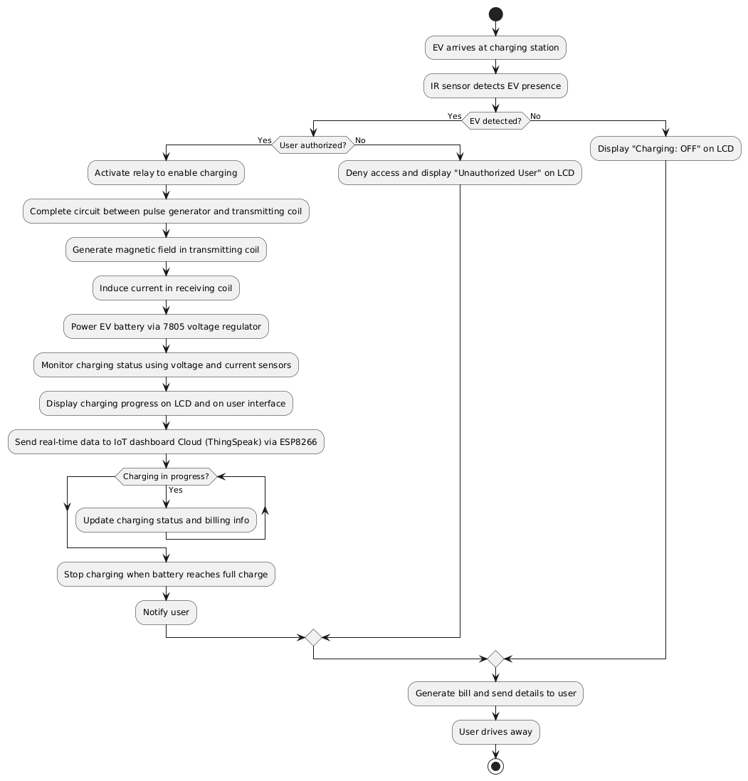
Use-case diagram
Notes:
Visuals are key. Add a process flow or use-case diagram to explain how the solution works. Ensure it's simple and easy to understand.

Slide 6
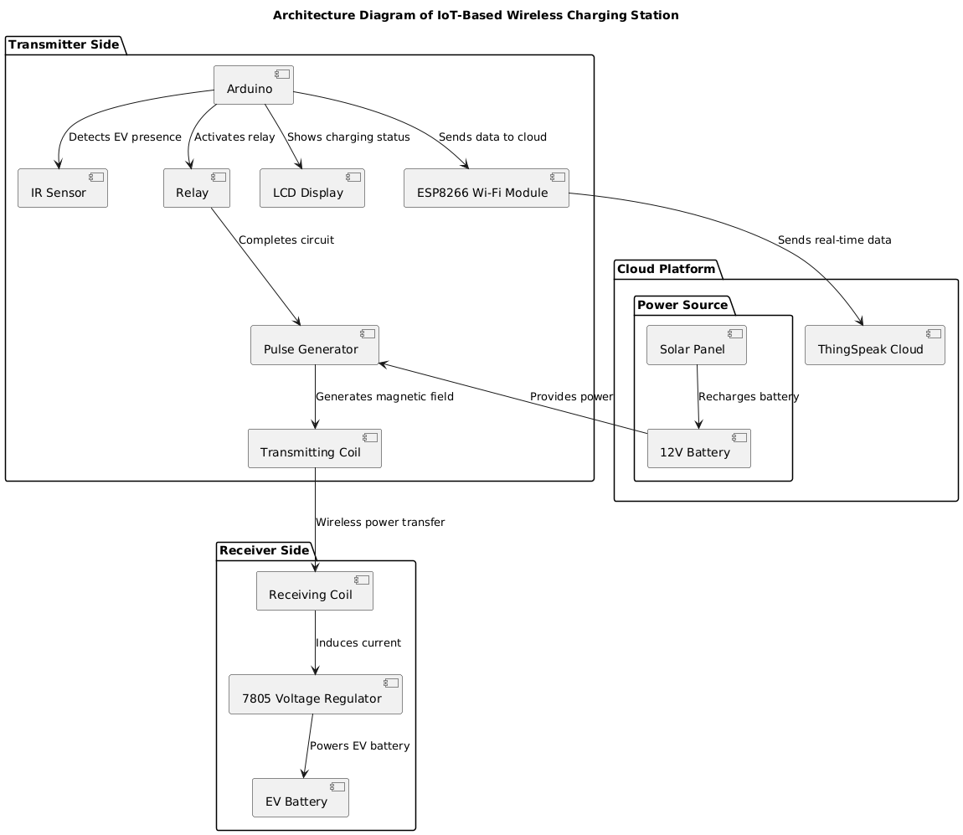
Notes:
Include an architecture diagram to showcase the technical structure of the solution. Clearly label components and their interactions.

Slide 7
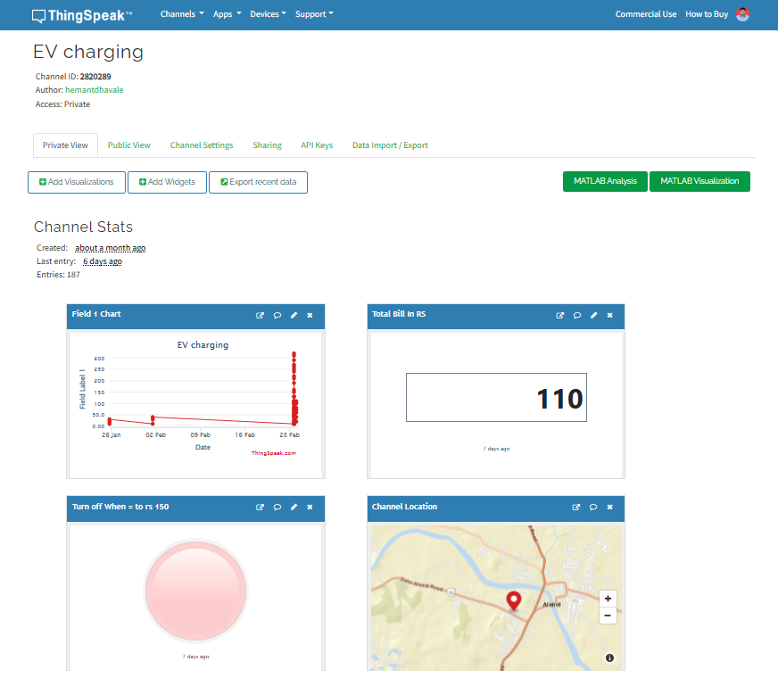
Snapshots of the Minimum Viable Product(MVP)
Notes:
Add snapshots of the Minimum Viable Product (MVP). Keep the demo video within 3 minutes

Slide 8
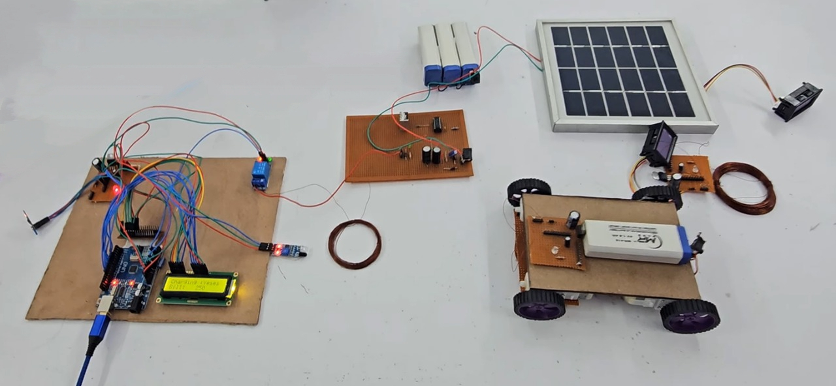
Notes:
Finally, use the last slide to detail any future development plans. This showcases the scalability and long-term vision of your project.

Slide 9
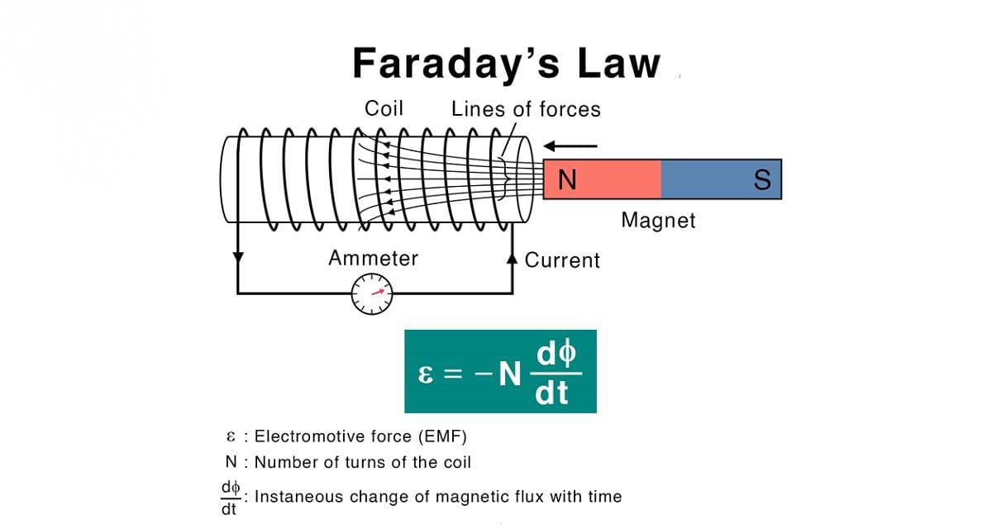
Notes:
In this slide, describe the solution briefly. Highlight what makes it unique compared to existing ideas, how it solves the problem, and the unique selling points or benefits of the proposed solution.

Slide 10
Technologies Used in Our Solution
🔹 Hardware Components:
Arduino UNO – Controls the system operations
ESP8266 Wi-Fi Module – Enables cloud communication
IR Sensor – Detects vehicle presence
Relay Module – Controls power transmission
Transmitting and Receiving Coils: These coils enable wireless power transfer via electromagnetic induction.
Pulse Generator & Coils – Enables wireless charging
7805 Voltage Regulator – Regulates power for EV battery
LCD Display – Shows charging & billing status
🔹 Software & Cloud Technologies:
Arduino IDE – Code development for Arduino
ThingSpeak Cloud – IoT data storage & real-time monitoring
Notes:
List all technologies employed. If your project uses Google developer technologies like Gemini APIs or is built on the IDX platform, mention them prominently to earn additional points.

Slide 11
Future Developments:
1️⃣ Mobile App with Smart Features 📱
🔹 Real-time charging slot booking & availability updates
🔹 Seamless digital payments (UPI, Credit/Debit Cards, Wallets)
🔹 Live tracking of charging progress & energy consumption
2️⃣ AI-Powered Predictive Maintenance 🧠
🔹 IoT sensors to detect faults before they occur
🔹 Automated alerts to minimize downtime & reduce repair costs
🔹 Machine learning algorithms to optimize power usage & efficiency
3️⃣ Fast-Charging & Multi-Vehicle Support ⚡
🔹 High-frequency resonant circuits for rapid wireless charging
🔹 Scalable system for charging multiple EVs simultaneously
🔹 Dynamic load balancing for efficient power distribution
4️⃣ Renewable Energy & Smart Grid Integration 🌞🔋
🔹 Hybrid model using solar & wind power for sustainable charging
🔹 Smart grid technology to optimize energy usage during peak hours
🔹 Battery storage systems to ensure uninterrupted power supply
Notes:
Finally, use the last slide to detail any future development plans. This showcases the scalability and long-term vision of your project.

Slide 12
Provide links to your:
GitHub Public Repository : https://github.com/HemantRambhauDhavale/-IoT-Based-Wireless-Charging-Station-for-Electric-Vehicles-

Slide 13

Notes:
And that’s it! With these slides, your presentation will be clear, concise, and impactful. Remember, creativity and clarity are your best friends in delivering a winning pitch!

